Slide 1

WELCOMES YOU

Slide 2
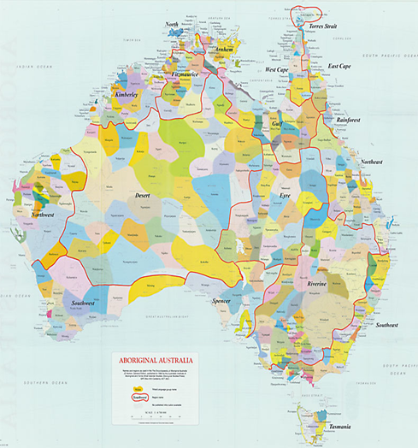
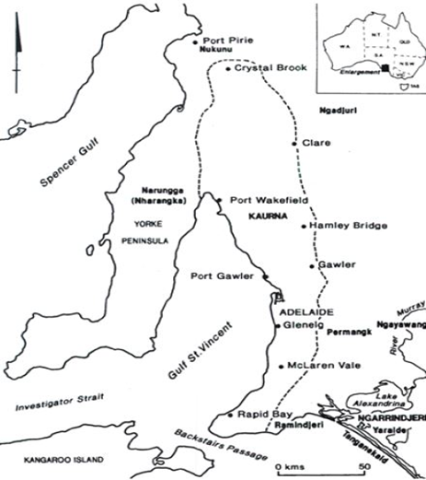
Meeting Opened
Acknowledgement of Kaurna Country
We would like to acknowledge this land that we meet on today as the traditional lands of the Kaurna people. We respect their spiritual relationship with their country and we would also like to acknowledge that the cultural and heritage beliefs are still important to the living Kaurna people today.
Source: Prof Mick Dodson 2013
Notes:
You tube Eddie Vedder Better Days

Slide 3
Welcome
Members
New Members
Non Members
Thank you
Abbott Diabetes Care
AMSL Diabetes Australasian Medical & Scientific Ltd
Astra Zeneca
BD Becton Dickinson
For Enquires Contact:
Caroline Ford
Mobile: 0487 386 626
Jenny Von Der Borch
Mobile: 0417 088 654
adeasa@adea.com.au

Slide 4

Tomorrow, Dec 5th is International Volunteers Day.
Has anyone got any plans to celebrate the day at their work?

Slide 5
Diabetes Educators can:
Build the role and profile of volunteers
Celebrate their efforts with gratitude
Show case the difference they make

Slide 6
OUR CURRENT S.A ADEA VOLUNTEERS:
 Lauren Botting- Credentailling Committee
 Jenny Johns- Education Organising Committee
 Effie Kopsaftis- Treasurer
 Jayne Lehman- Program Organising Committee
 Christine Lester- Credentialling Committee
 Lily Mountain- Program Organising Committee
 Thelma Muchenje- Education Organising Committee
 Luisa Pinto- Education Organising Committee
 Neroli Price- Education Organising Committee
 Barbara Sawyer- Program Organising Committee
 Pamela Smith- Secretary
 Diana Sonnack- National Board
 Jenny Von Der Borch- Co-Chair

Slide 7
AGENDA Branch Meeting
1.1 Present / Apologies- Attendance, Recording permission/ID badge
1.2 Apologies in advance: Jenny Von Der Borch, Jayne Lehmann, Lilly Mountain
1.3 Call for Member to Accept the minutes from Sept 10th 2014 meeting
2.0 Business Arising from meeting 4th December
2.1 Outgoing Chair of Education Committee: Thank you Teresa Barter
2.2 Correspondence– Pam Smith, Secretary

Slide 8
2.3 Finance
Effie Kopsaftis
Profit & Loss
1/7/2014 to
27/11/2014
2.4 National Board
Member:
Diana Sonnack

Slide 9
ADEA Board training
Board members undertook Governance Training on Friday 21st November with Leah Fricke LLB(Hons)/BA, MBA, FGIA, FCIS, MAICD.
Leah is a Governance Consultant and Non-Executive Director - has over 20 years legal experience and 10+ years in management roles working in a range of industries at all stages of development & maturity.
20 years as a governance professional in both private and public companies - has worked extensively with not for profit organisations to assist them to clarify the most efficient and productive role for a voluntary board to ensure appropriate monitoring and engagement with management and key stakeholders.
This was a successful day and Directors were updated about the role of a board, relevant legislation and the need to be strategic in their thinking.

Slide 10
Role & scope of practice for cdes in Australia
ADEA is aware of the complexity of the interpretation of the Role and Scope of CDEs in Australia regarding the multidisciplinary health professional background of ADEA members being eligible for credentialling.
This important document has had wide consultation with the membership as NO is cognizant that member input would ensure this document is informed and therefore of most benefit to all of our Members.
This included a survey that closed at the end of May advertised in the ADEA weekly update.
Following wide membership consultation it has been updated with evidence and reflects current changes within the health environment.
At the Board meeting in November it was reviewed and endorsed by the Board. It will be made available to the members once it has gone through the editorial process in the very near future.

Slide 11
Constitutional changes
The ADEA Constitution is under review and it is anticipated that the final version will be presented at the next ADEA AGM in Adelaide for approval.
The aims of the Constitution are to provide:
  Fundamental rules for decision making by governing body and management,
  Assurance for the public and stakeholders,
  Guidance for governance.
In addition it facilitates good governance and accountability – enabling the organisation to stay relevant and be able to be productive in a changing environment.
At present the Constitution Sub-committee is being led by Director Heike Krausse and includes other members; John Michailidis (Skilled Based Director), Fiona McIvor, Jayne Lehmann, Jan Alford and Carol de Groot. Member feedback and legal advice has been sought to support this process.

Slide 12
Constitutional changes
To date there have been two articles published in the ADE to provide members with relevant information on the need for change and the process thus far.
In addition, two PowerPoints slide decks have been provided to members for discussion at state level meetings.
We encourage members to become interested in this process and relay any concerns as soon as possible so that the process can continue smoothly and in a timely manner.
Feedback can be provided at constitution@adea.com.au

Slide 13

Cde of the year
This program is being launched by the Hon Peter Dutton MP for ADEA at Parliament House on Tuesday 25th November.
The awards honour Credentialled Diabetes Educators who have demonstrated leadership and excellence in diabetes education, with the recipient of the ‘Jan Baldwin National CDE of the Year’ award receiving $5,000 towards attending educational events.
If you would like to nominate an outstanding Credentialled Diabetes Educator for the Award, go to the ADEA weekly update this week or read the article published in the Spring edition of the Diabetes Educators publication or access the information on the ADEA website www.adea.com.au.

Slide 14
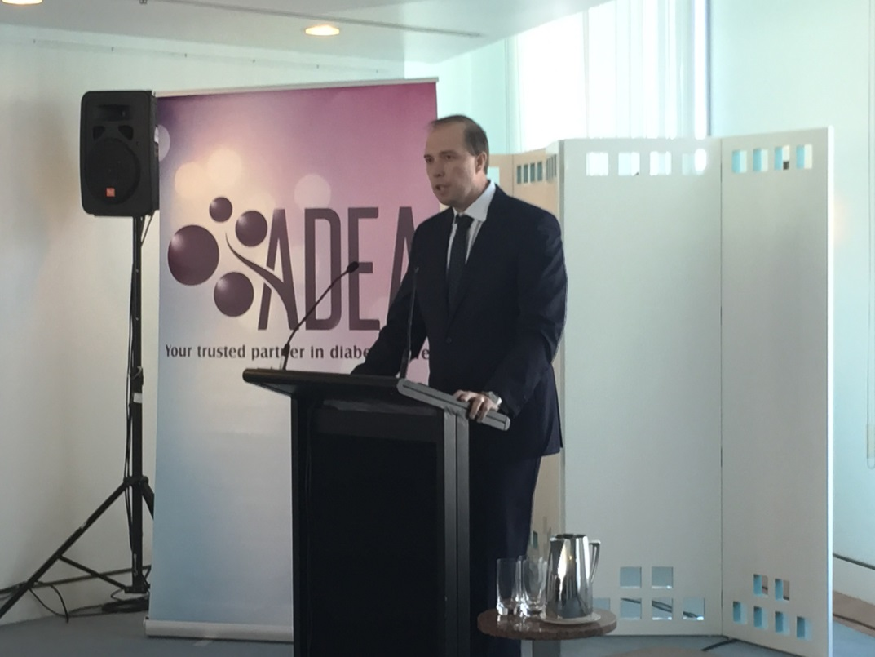
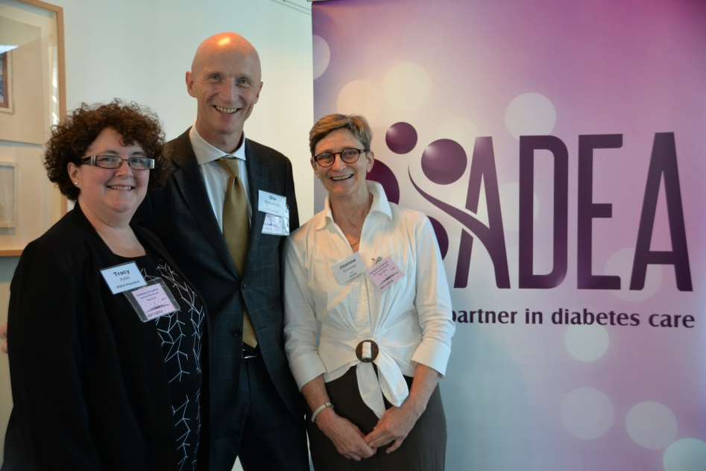
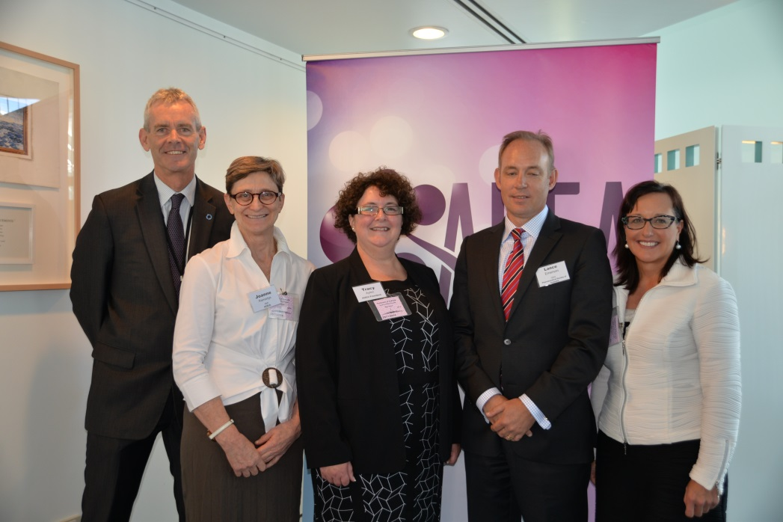

Slide 15
Eligibility for Credentialling – Physiotherapists and Pharmacists
ADEA recently received two applications for consideration regarding primary health discipline eligibility for credentialling as a credentialled diabetes educator through ADEA. These submissions were from:
1- Pharmaceutical Society of Australia and the Pharmacy Guild for the removal of the requirement that Pharmacists must be accredited to provide Medication Management Reviews to be eligible for credentialling.
2- Physiotherapists Association to enable registered physiotherapists to be eligible for credentialling.
These submissions have gone through the credentialling committee and it has been found that they meet the criteria for credentialling recognition. These submissions were therefore approved at the last Board meeting.

Slide 16
Position Statement – Non Medical Prescribing
The new position statement and the complementary background document, Australian Credentialled Diabetes educators and prescribing of Insulin and glucose lowering medications
This is an aspirational paper indicating to policy makers and other relevant stakeholders where ADEA sees its position in terms of these issues.
This has now gone through wide membership and stakeholder consultation and has been approved at the recent Board meeting.

Slide 17
State conferences
NO is aware of the commitment and volunteer time of members to establish a successful conference.
The CEO has attended branch meetings to explain the role of branches and the relationship with NO and that NO staff would like to better support the branch executives and members.
NO is in a position now with relevant personnel with differing skill mix to support and work in collaboration with branches to better support them in undertaking the administrative and financial aspects of events.
These might include working with branches to develop a budget for the event, source cost effective venues etc.
Branches would retain all control over speakers and programming. We encourage each branch to get in contact with the NO when planning their state workshop or conference for this assistance.

Slide 18
Adea leverage
Our CEO has been busy meeting with relevant stakeholders and Ministers sharing the outcomes of the Delloitte Access Economics paper “Benefits of CDEs to people with diabetes and Australia”.
The report reveals that people with diabetes supported by structured education achieve better blood glucose management and are less likely to be hospitalised for secondary complications than people who forgo education.
This report has been received well by stakeholders: Federal Ministers, Private Health Fund Collaborative .

Slide 19
2.5 Continuing Education-Neroli Price/All
2.6 Credentialling–Lauren Botting
2.7 Podcast –Analytics
3.0 New Business
3.1 CDE of the year
3.2 CQI adeasa@adea.com.au & CQI box
3.3 S.A ADEA Branch Facebook Page to
encourage sharing & support

Slide 20
3.4 Call for ADEA related groups to present (Country Health- Next)
3.4 Website- Sharing S.A Professional documents (DNE Handbook)
3.5 Call for members to share quick
practice tip or resource
3.6 Journal Club interest list
3.7 Research collaboration interest
3.8 PPSIG- Read e-mail from Jayne
3.9 Further new business (time
permitting)

Slide 21

4.0 Next meeting
3rd March 2015
5.0 Meeting Closed &
Festive Greetings

Slide 22

PRESENTATION
  Sandra Daugalis:
  Senior Dietitian Lyell McEwin Hospital.
  Passion for type 1 & pumping.
  Tile: “Getting started on
  Carbohydrate Counting
  & Case Study”

Slide 23
Summary

