Slide 1


Slide 2
board core brief
February 2015

Slide 3
ADEA Business Development
New Diabetes Educator categories:
Opportunities exist within ADEA’s business development activities to support a stronger approach to developing current income streams through branch and national conferences, sponsorships/partnerships and greater use of digital technology.
Consideration is also being given to how Aboriginal Health Workers/Practitioners (AHW&P) can be included as a category within diabetes education.
These actions are being explored to meet the vision and mission of ADEA as often AHW&Ps are the only health worker in many Indigenous communities in rural and remote areas.
This is seen as an exercise in capacity building and there will be opportunities for discussions by membership.

Slide 4
ADEA Business Development
Partnerships - AADE/CDA Visit:
The CEO whilst on personal travel abroad took the opportunity to visit with the American Association of Diabetes Educators.
The value of this visit was the opportunity to meet key people in AADE in person and discuss similarities and differences making future contact much easier.
Opportunity to strengthen an alliance with them especially in relation to working collaboratively with AADE and Canadian Diabetes Association on replicating the Deloitte Access Economics report.
AADE is keen to collaborate with ADEA and we had the opportunity to strengthen the relationship in respect of discussions already commenced with AADE and CDA about this project.
AADE has offered ADEA an opportunity to explore the use of their resources under license.

Slide 5
ADEA Business Development
Financial Integrity:
The ADEA engaged an independent financial advisor for review of ADEA investments
This has been a very positive exercise supporting our financial integrity through North Investments.
To date we have already had good returns and the Board will make a decision through a draft budget process for 2015-16 about how we will use these funds to strengthen ADEA.
ADEA POC co-chairs are Elizabeth Obersteller (clinical co-chair) and Joanne Ramadge. The POC has been very productive with three symposia, 2 masterclass and a workshop almost finalised that include topics on nutrition, resilience, social media, and private practice.

Slide 6
Constitutional changes
The ADEA Constitution is now well into its consultation and discussion phase.
PowerPoints have been provided to Constitutional Champions to support discussions and update at state branch meetings.
The aims of the Constitution are to provide: Fundamental rules for decision making by governing body and management, assurance for the public and stakeholders, and guidance for governance.
In addition it facilitates good governance and accountability – enabling the organisation to stay relevant and be able to be productive in a changing environment.

Slide 7
constitutional changes
At present the Constitution Sub-committee is being led by Board Director Heike Krausse and includes other members; John Michailidis (Skills Based Director), Fiona McIvor, Jayne Lehmann, Jan Alford and Carol de Groot.
Member feedback and legal advice has been sought to support this process. Member feedback can be provided at constitution@adea.com.au

Slide 8

cde of the year
This program was launched by the Hon Peter Dutton MP for ADEA at Parliament House on Tuesday 25th November.
The awards honour Credentialled Diabetes Educators who have demonstrated leadership and excellence in diabetes education, with the recipient of the ‘Jan Baldwin National CDE of the Year’ award receiving $5,000 towards professional development activities.
If you would like to nominate an outstanding Credentialled Diabetes Educator for the Award, go to the ADEA weekly update this week or read the article published in the Spring edition of the Diabetes Educators publication or access the information on the ADEA website www.adea.com.au.

Slide 9
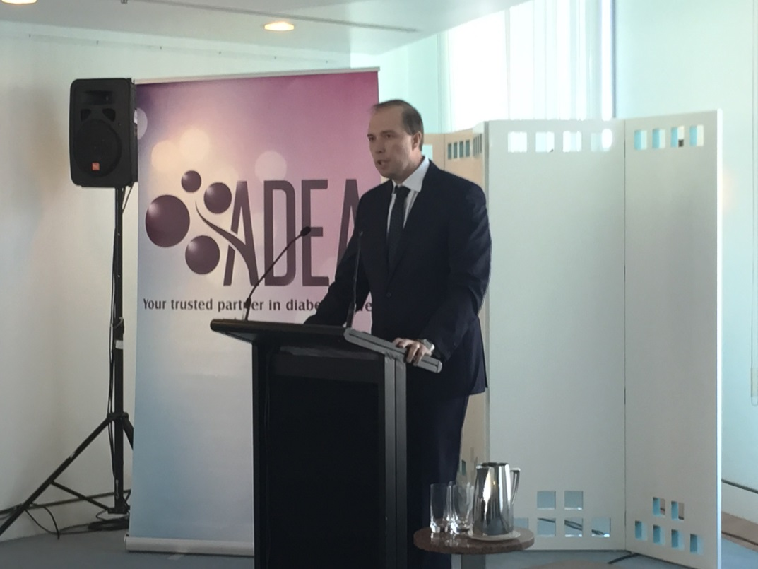
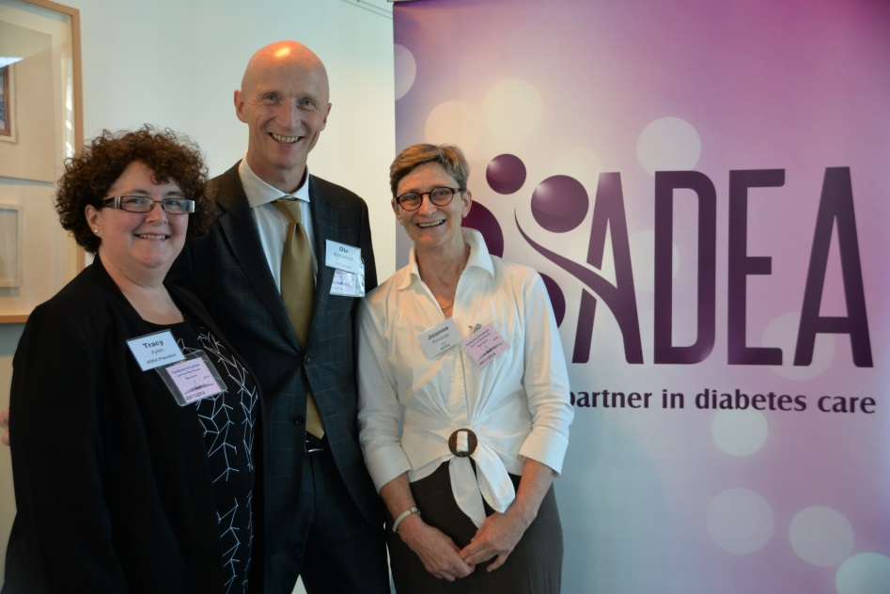
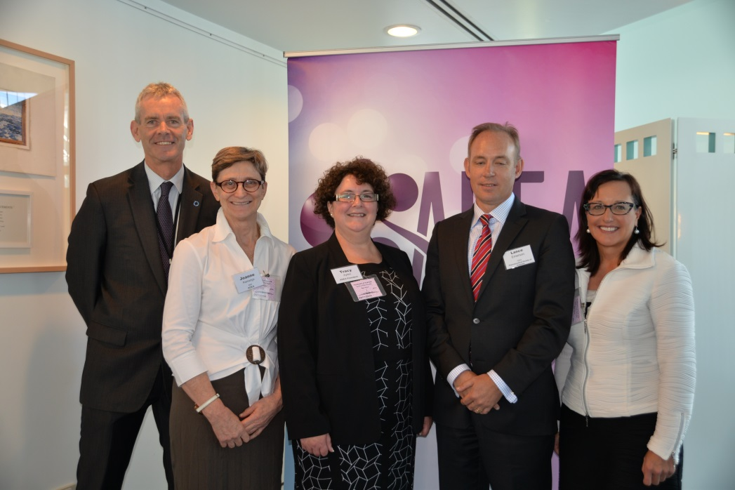

Slide 10
adea leverage/influencing government policy
Exemplars of activities undertaken in this area are provided below for this last quarter:
ADEA has already raised workforce issues in the submission to the ‘Senate Inquiry into Health’ that covered a range of workforce issues e.g.
CDE positions being made redundant, CDE hours being reduced
CDE specialist roles being replaced by more generic roles.
ADEA was invited to give evidence before the Senate consultative committee.
Submission into the ACCC review of private health insurance has been submitted highlighting the effects of a more heavily privatised health care system would have on the nation.

Slide 11
adea leverage/influencing government policy
Engagement with Pharmaceutical Society of Australia and Australian Physiotherapy Association to promote CDE role to members.
Joint submission with Exercise and Sport Science Australia and Dietitians Association of Australia to government on Extending eligibility under Medicare ‘Allied Health Group Services for patients with Type 2 Diabetes Mellitus’ items to pre-diabetes following recent freeze on rebates for Medicare item numbers.
ADEA represented by 3 CDEs at the Networking Health NSW Roundtable n Allied Health in current/future primary care services.

Slide 12
membership
Recently the ADEA has undertaken a review of its membership and updated its database that better supports membership data on existing CDEs.
The membership has risen to 1818 and a new category of membership includes students undertaking post graduate qualification in diabetes.

Slide 13
research framework
A Research Advisory Group has been established
The offer to pilot and provide feedback on the research toolkit and register was well received with over 80 interested members.
A research framework communication plan has been approved by the RAG and the implementation process has commenced.
The register and toolkit development is being undertaken by the International Centre for Allied Health Evidence (ICAHE) at the University of South Australia.

